Slide 1
Exploratory Data Analysis of BMI and Weight-Related Health Trends in the U.S. Population

Slide 2
Introduction
The prevalence of obesity and related health conditions has become a significant public health challenge in the United States. This project explores trends in body mass index (BMI) categories—specifically, normal weight, overweight, and obesity—among adults in the United States using data from the National Health and Nutrition Examination Survey (NHANES). The aim is to uncover patterns in weight status across different demographic segments and over time.

Slide 3
Data Source
The data utilized in this project is sourced from NHANES and accessed through the U.S. government’s Data Catalog. The dataset focuses on adults aged 20 and over and includes multiple demographic and temporal variables that enable comprehensive analysis.

Slide 4
Data Description
The dataset includes a range of variables designed to support an in-depth examination of BMI categories within the U.S. adult population. Key variables include Health Status, BMI Category, Population Percentage Type, Demographic Category, Age Range, Survey Period, and other relevant metrics.

Slide 5
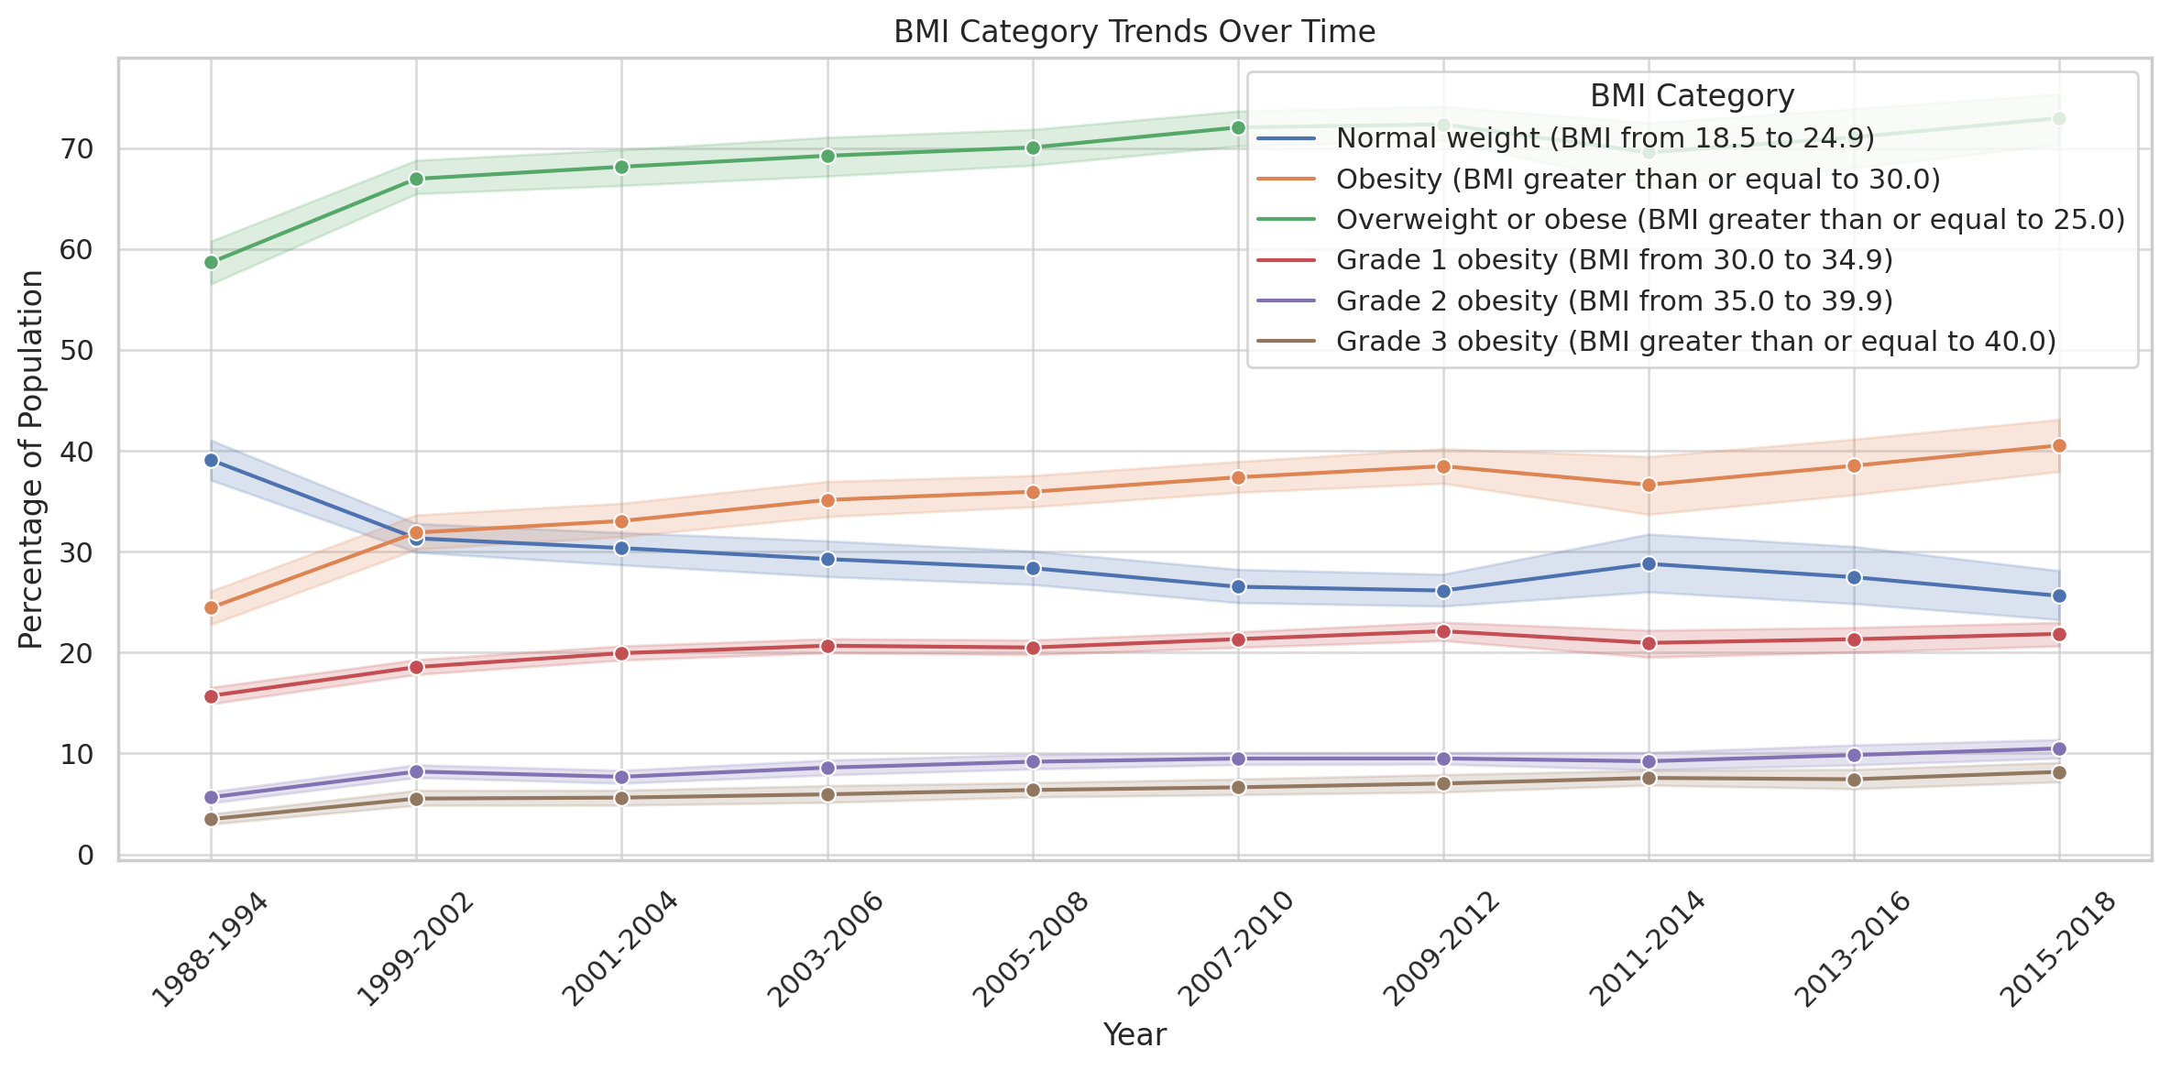
DATA VISUALIZATION
BMI Category Trends Over Time. This line chart illustrates how the percentage of the population in each BMI category (normal weight, overweight, and obesity) has changed across different years.

Slide 6
Methodology
Key Steps
Environment Setup: The project was developed using Python, employing libraries like pandas for data manipulation, matplotlib and seaborn for visualization.
Data Loading: The dataset was loaded from Google Drive for analysis in Google Colab.
Initial Exploration: Included displaying the first few rows, examining data types, checking for missing values, and reviewing descriptive statistics. This set the foundation for data cleaning and preparation.
Data Cleaning: Handled missing values, optimized data types, dropped redundant columns, and renamed columns for consistency.

Slide 7
Data Transformation and Feature Engineering
New features were created to facilitate analysis, including age grouping, survey midpoint calculation, and BMI category encoding. This enabled more comprehensive and sorted visualizations.

Slide 8
Exploratory Data Analysis
BMI Distribution Across Age Groups
Findings revealed that BMI categories tend to shift upwards with age. Higher prevalence of obesity among middle-aged and older adults suggests the need for age-specific interventions.
BMI Comparison by Demographics
A bar plot showed disparities in BMI prevalence across sex and race, indicating the need to consider cultural, socioeconomic, and environmental factors in public health policies.
Standard Error Distribution by BMI Category
Standard errors were generally consistent across categories, with higher variability in extreme BMI ranges, indicating reliable estimates overall.
Heatmap Visualization
A heatmap highlighted an upward trend in obesity estimates, particularly among middle-aged and older adults.

Slide 9
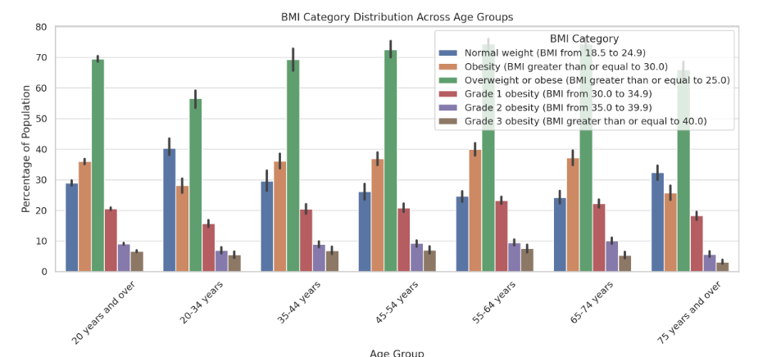
BMI Category Distribution Across Age Groups
It provides a comparison of the population percentage in each BMI category for different age groups.

Slide 10
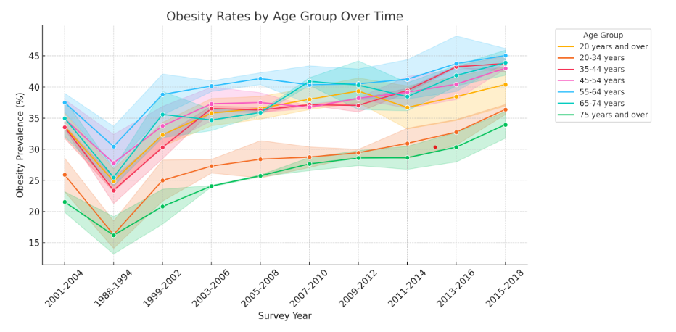
demographic or age-related obesity rates
This visualization highlights how obesity prevalence changes across different age groups, emphasizing the higher rates in middle-aged adults. This graph can help identify the demographic that might benefit most from targeted health interventions, such as workplace wellness programs for middle-aged adults.

Slide 11
Insights and Recommendations
The analysis provides several insights into BMI and weight trends: Older adults exhibit higher obesity rates, there is a clear upward trend in obesity rates over time, differences in obesity prevalence suggest a need for culturally specific interventions, and BMI estimates are generally reliable across categories.
Design a health intervention focused on middle-aged adults, promoting accessible physical activity options, nutritional guidance, and regular health screenings. The program could partner with workplaces to integrate wellness workshops and offer incentives for participation in fitness and health monitoring programs.

Slide 12
Conclusion
This exploratory data analysis reveals critical trends in BMI and weight status among U.S. adults, influenced by age, time, and demographic factors. Addressing the obesity epidemic requires age-specific programs, culturally tailored outreach, and policies promoting healthy lifestyles to ensure a healthier future for all demographic groups.
Data Needs to exploring additional factors (e.g., lifestyle or socioeconomic data) to gain deeper insights into BMI trends.

Slide 13
Thank you

